Slide 1


Level One Project and Principles – Part 2
Mojaloop Convening
Kigali November 2024
The Level One Project is an initiative of The Bill & Melinda Gates Foundation
1

Slide 2



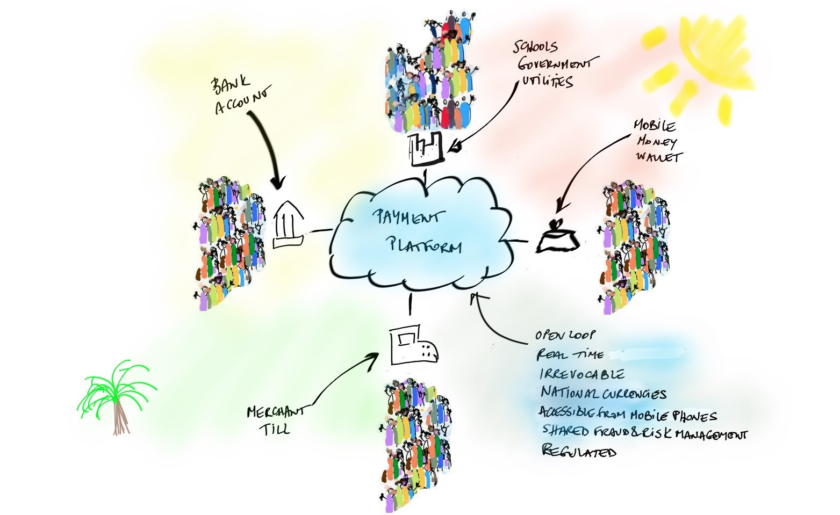


Level One Project
Affordability
Low Cost Scale Safe
Usefulness
Reliable Inclusive Ubiquitous
Provides a vision for an inclusive instant payments system that supports inclusive, interoperable digital economies, and the design principles to meet user requirements
Develops a set of tools and resources to enable the implementation of a real-time retail payment system that is aligned with the Level One Project principles
Shares a blueprint for how such a system could be configured within a country or region
Bill & Melinda Gates Foundation, 2024

Slide 3
Remind Me About Scheme Governance…
The collection of management approaches, decisions, and oversight functions within the payment scheme.
Importantly, governance is an activity in the collaborative space and should be a critical consideration when creating or transforming a scheme to meet the goals of financial inclusion.
Governance determines or sets the tone for everything that occurs in the scheme.
Scheme Governance is different than the IIPS Project Governance
3

Slide 4
Codifying Scheme Design Decisions
Scheme Rules
The rules governing participants’ activities within the IIPS Scheme.
The scheme rules provide a robust ruleset for participation.
There may also be multiple appendices which contain additional detail.
Operating & Technical Guidelines
The Operating and Technical Guidelines is a that provides the operational, technical, and functional details that participants and non-participant entities need to implement and observe within the Scheme.
Participation Agreements
The contract between the Scheme Owner and an Entity binding both parties to the unique aspects of each set of Scheme Rules. The Scheme may have different types of Participants with categories and eligibility defined in the Scheme Rules.
Different Agreements are developed for different Participant Types.
Other Agreements may also be developed for other non-Participant entities (e.g., Payment Initiation, Technology Provider).
3

Slide 5
Scheme Governance Models
Central Bank Led
Commercial Led
Association Led
May or may not formally include participants in decision making
May be focused on a single scheme, multiple schemes or have many initiatives and activities
May be public or private
May be owned by a segment of scheme participants
May or may not formally include participants in decision making
May be focused on a single scheme, multiple schemes or have many initiatives and activities
May or may not be mandated by regulation or law
May have open or closed membership
May or may not have formal Central Bank representation
3

Slide 6
Inclusive Scheme Governance
There are three critical components of governance that should be pursued to best promote financial inclusion.
These are:
Components
Equal Ownership
All direct participants of the scheme (banks and non-banks) are provided equal ownership opportunities in scheme governance as well as in scheme payment operations.
Participant Engagement
Direct and indirect participants are provided formal and informal mechanisms to provide input on the direction of the scheme, including the scheme rules.
Ensuring a Pro-Poor Posture
The scheme operates as a not-for-loss and the entity managing the scheme maintains a pro-poor posture where payments are considered a shared utility not a profit maximizing activity.
3

Slide 7
IIPS Economic Model Related Principles
Pro-poor scheme governance: The scheme operates on a not for loss model and the entity managing the scheme maintains a pro-poor posture where payments are considered a shared utility, not a profit maximizing activity. Often referred to as cost-recovery plus investment
Low or no end user fees: Fees to end users (individuals, merchants, billers, government agencies, and other enterprises) should be zero or low, and may vary by use case. DFSPs are expected to realize their revenue from adjacent, value-added services, rather than from payment fees

Slide 8
What Does “Not-For-Loss” Basis Mean?
The scheme itself runs on a “not-for-loss” basis – i.e., not a for profit venture
Scheme fees cover cost of doing business and additional investment requirements
The operating platform may be provided by the scheme or could be a commercial entity under contract to the scheme
Allows DFSPs and others to create low-cost products and services in the ‘competitive space’ but does not prohibit DFSPs from acting on a for-profit basis

Slide 9
IIPS Platform Capabilities
IIPS
Payer
DFSP
DFSPs
Payee
Scheme
Operating
Platform
Switch Directory Settlement Fraud Management
Settlement Bank

Slide 10

Within The IIPS, There are Three Core Roles
Scheme Owner:
Platform Operator:
Participants:
The entity that owns the scheme and is responsible for scheme governance including rules writing
The entity that manages the platform and is responsible for processing transactions in line with requirements defined in scheme rules
The individual DFSPs (banks and non-banks) that have signed agreements binding them to scheme rules, allowing them to connect to the platform for the purpose of availing scheme services

Slide 11
What is ‘Clearing’ and Settlement in an IIPS?
The clearing phase is the exchange of information about a payment prior to settlement, potentially
including the netting of transactions, and the establishment of positions for settlement of transactions
between participants
Clearing in an IIPS occurs instantly and on a continuous basis
We use the term ‘settlement’ to talk about inter-institutional settlement – this is different from end-user settlement
Settlement can be deferred net or real-time (gross)
End-User Settlement
End-User Settlement
Payer
DFSP
IIPS
DFSP
Payee
Institutional (DFSP) Settlement

Slide 12





Identifier / Addressing Options
Mobile Phone Number
National ID or Proxy
Email Address
Any Identity (Digital Wallet)
Random Generated Alias
Chosen Alias
An alias that is created by the end user, typically with a string of letters and numbers (i.e.
McIceCream22)
A randomly generated Alias produced by the scheme, assigned to the End User (until the End User relinquishes it)

Slide 13


BMGF Fraud Mitigation Principles
Principle 1: Liability
End users are not liable for confirmed fraudulent payments.
Principle 2: Rules
The IIPS guides DFSPs in managing fraud risk through their scheme rules.
Principle 3: Tools
The IIPS provides fraud mitigation tools and share in the investment.
Principle 4: Data
The IIPS establishes fraud data and information-sharing guidelines and mechanisms.
Bill & Melinda Gates Foundation, 2024 Source: BMGF Fraud Principles (forthcoming) 13

Slide 14
Implementing an IIPS is a Significant Undertaking
More than hardware and software -- L1P Aligned Payment Scheme Entities and Roles
1. Government
Payment Scheme Governing Body
Payment Scheme Ownership Body
Payment Scheme Rules
5. Payment Scheme Operator
6. Retail Service Provider Participants
Payment Platform Service Provider
SW, HW, Network Platform
9. SW stack
Government | Scheme focus – varies by local context | Scheme Governance | Payment Service Providers | Platform Operator/ Manager
Bill & Melinda Gates Foundation, 2024
14

Slide 15
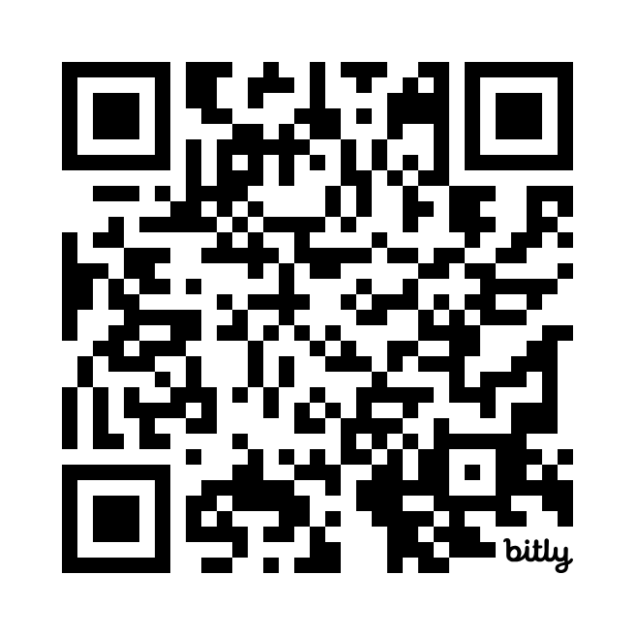
We need your input!
Tell us what you’d like to see in the next Level One website.
What resources do you need to design and build your IIPS?
URL:
bit.ly/L1Pwebsurvey
15

